Slide 1

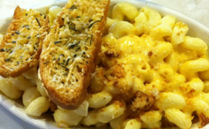
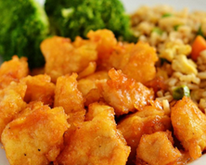
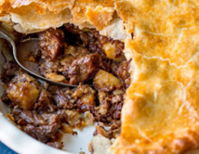
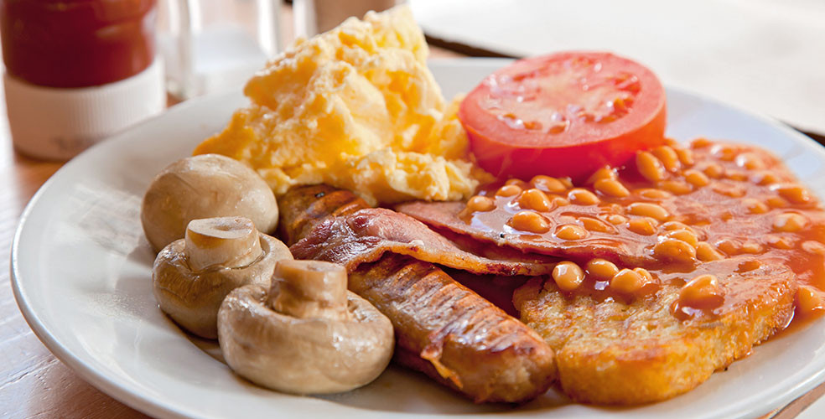
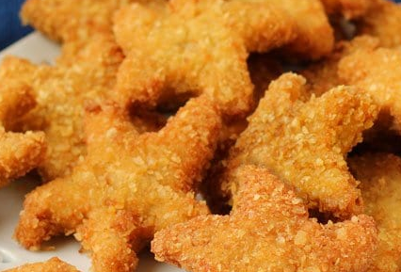
Your Menu This Week
Week 2 Commencing
2023
Main Dish
Vegetarian
Jackets
Please note, that our menus could be subject to change due to nationwide supply issues.
Main Dish
Dessert
Monday
Macaroni cheese garlic bread and salad G,MK,SE
Vegetarian enchiladas garlic bread & salad
G,MK,SE,S
With various
fillings and salad
Sultana and Oat Cookie G,E,SE
or Fruit
Allergens & Intolerances:
G=Gluten
MK=milk
M=mustard
S=soya
SE=Sesame
E=Egg
SD=Sulphur dioxide
C=Celery
F=Fish
Tuesday
Sweet chilli chicken
With rice and broccoli
Vegetarian Mexican stack with salad/ garlic bread
G,MK,SE,S
With various
fillings and salad
Iced cherry sponge or
G,E,MK Fruit
Wednesday
Meat & potato pie roast potatoes
Carrots/cabbage
G
Vegetarian chicken roast with roast potatoes carrots/cabbage S
With various
fillings and salad
Strawberry Whirl
or Fruit MK
Thursday
All day breakfast served with tomatoes and mushrooms
C,G,E,MK,SD,S
Vegetarian breakfast with tomatoes and mushrooms
C,G,E,MK,SD,S
With various
fillings and salad
Pear & Chocolate Sponge with Chocolate Sauce or fruit G,E,MK
Friday
Fish Stars with Chips & Beans
G,F
Vegetarian sausage roll chips and beans
G,S,SD
With various
fillings and salad
Fruit or Yoghurt
MK

