Slide 1
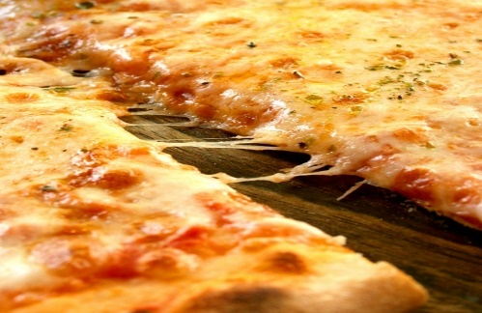
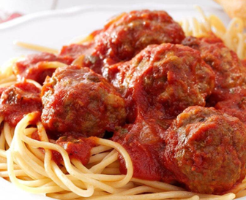
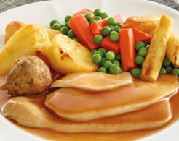
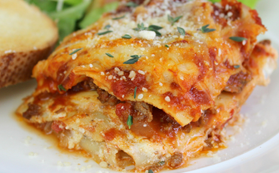
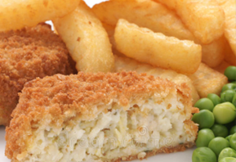
Your Menu This Week
Week 1 Commencing
2023
Main Dish
Vegetarian
Jackets
Please note, that our menus could be subject to change due to nationwide supply issues.
Main Dish
Dessert
Monday
Homemade Pizza potato wedges peas G,MK
Spanish Omelette potato wedges peas E,MK
with various
fillings served with salad
Ginger Biscuit
G or fruit
Allergens & Intolerances:
G=Gluten
MK=milk
M=mustard
S=soya
SE=Sesame
E=Egg
SD=Sulphur dioxide
C=Celery
F=Fish
Tuesday
Pork meatballs with spaghetti and tomato sauce
Sweetcorn G,MK,SE
Veggie meatballs with spag & sauce with sweetcorn
S,G
with various
fillings served with salad
Iced sponge G,E,MK or Fruit
Wednesday
Roast chicken breast with stuffing roast potatoes & mixed veg
Vegetarian sausage, roast potatoes, mixed vegetables G,S,SD
with various
fillings served with salad
Apple crumble & custard or fruit
SE,G
Thursday
Lasagne with garlic bread & salad or broccoli
G,MK,S,SD
Mascarpone pasta
With garlic bread & salad or broccoli
G,MK
with various
fillings served with salad
Chocolate cornflake cake or fruit G
Friday
Fishcake
chips and peas
G,F,MK,M
Golden toastie chips and salad
G,MK,SE,S
with various
fillings served with salad
Sultana flapjack
or Yoghurt
G,SE

