Slide 1
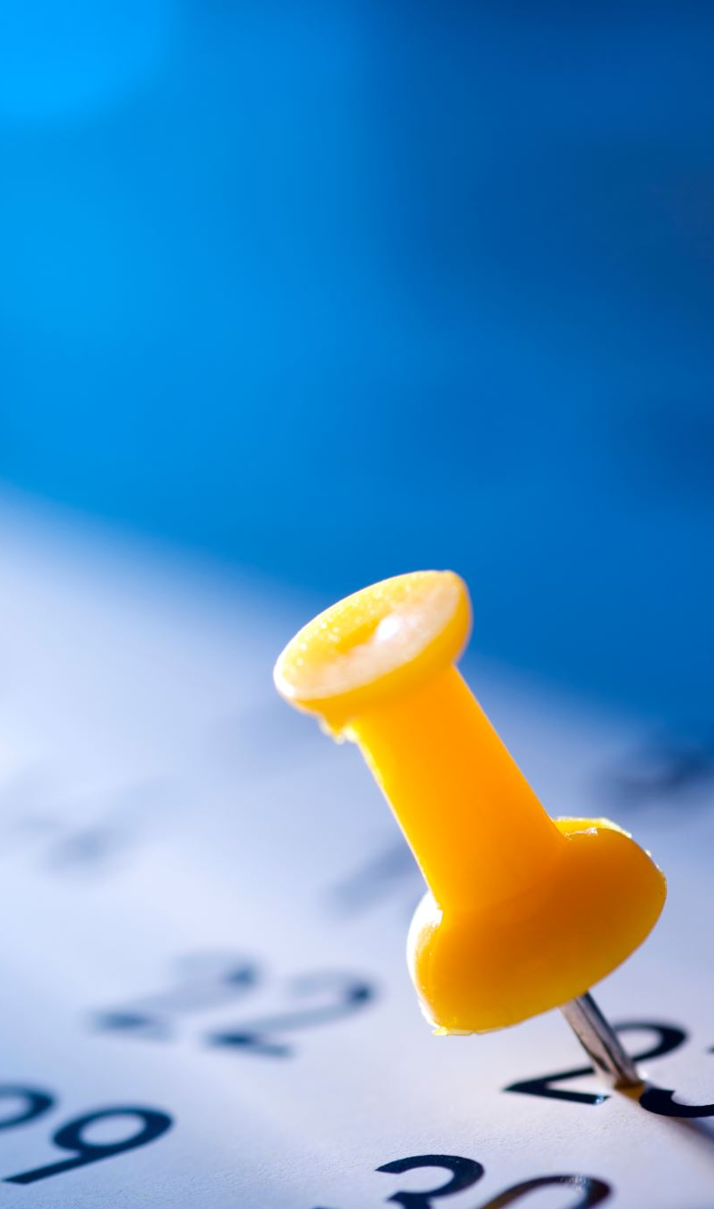
Welcome to the Multiplication Check Information Evening

Slide 2
The Multiplication Tables Check
The purpose of the check is to determine whether your child can fluently recall their times tables up to 12, which is essential for future success in mathematics. It will also help us to identify if your child may need additional support.
It will take place between the 2nd and 13th June 2025.

Slide 3
What is the Multiplication Tables Check?
It is an on-screen check consisting of 25 times table questions.
Your child will be able to answer 3 practice questions before taking the actual check.
They will then have 6 seconds to answer each question.
On average, the check should take no longer than 5 minutes to complete

Slide 4
What if my child cannot access the multiplication check?
There are several access arrangements available for the check, which can be used to support pupils with specific needs.
The check was designed to be inclusive and accessible to as many children as possible.
If you have any concerns about your child accessing the check, feel free to discuss this with Mrs Faryniarz or myself.

Slide 5
How can I help my child prepare for the Multiplication Tables Check?
Quick-fire questions on the way to school.
Creative methods for the house (notes on the fridge, stairs, mini-test while waiting for PlayStation to load etc)
Practice on TT Rockstars, Purple Mash or Maths Frame.
Kids vs Parents quick quizzing.
Remember the key things is that they know the facts without counting! (within 6 seconds)
Songs – Youtube has plenty of great times tables songs.
TT Rockstars five minutes a day!

Slide 6
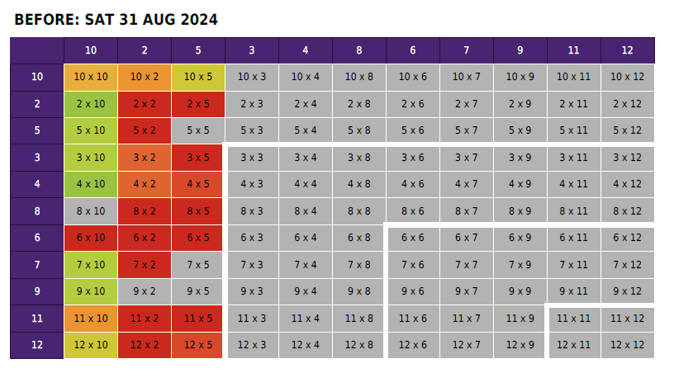
TT Rockstars five minutes a day!

Slide 7
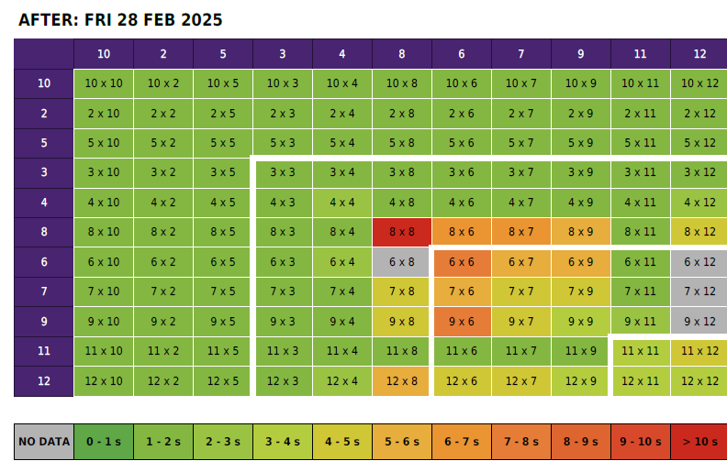
TT Rockstars five minutes a day!

Slide 8
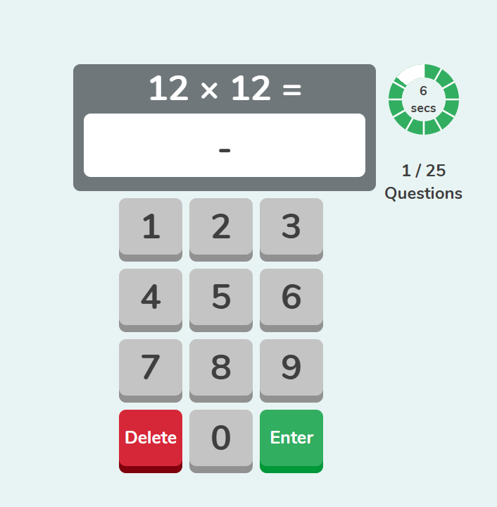
Have a go yourself!

Slide 9
mathsframe.co.uk/en/resources/category/7/multiplication-and-division
Purple Mash | Computing, Maths, English and more - 2simple.com
Hit the Button - Quick fire maths practise for 6-11 year olds
Times Tables Rock Stars – Times Tables Rock Stars
8 Times Table Song (You Belong With Me by Taylor Swift) Laugh Along and Learn
7 Times Table Song | The Bare Necessities | Laugh Along and Learn
Times tables games and songs 1-12 - BBC Bitesize
Some useful links and resources:

Slide 10
What about the results?
There is no pass mark for the check, although we aim for 20+/25.
We will have access to all of our pupils’ results, to allow us to identify pupils who need additional support.
We will also share your child’s score with you.

