Slide 1


Curriculum evening
2025-2026
Teaching and learning information for parents

Slide 2
Settling in
Settling in
Wednesday 3rd 9:30am-12pm
Thursday 4th 8:50-1:30pm (children will stay for lunch)
Friday 5th 8:50am – 2:30pm
Baseline assessment
Class rules
Behaviour – sunshine, rainbow etc…
All about me
Nursery rhymes (mini bags)

Slide 3
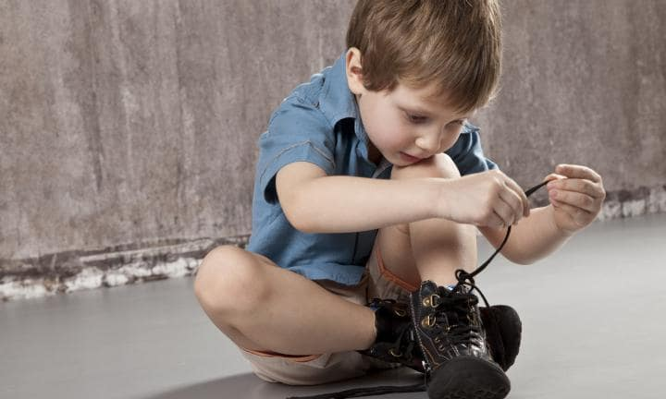


Reminders
PE kits – outdoor shoes
Names on everything!!!
No jewellery of any sort in school
All children need to bring in a water bottle
Book bag
Shoes – can your child put on their own shoes?
Toileting

Slide 4

School Street

Slide 5


Timetable and organisation
PE days are on a Tuesday and Friday. Children will need to come into school in their kits (white top, black joggers and black trainers)
Nature school on a Thursday (clothing)
Homework Mon-Mon starting in week 3
Reading books expectation is to read every night (not the whole book!)
Reception fund (parent pay)

Slide 6


All about me
All about me box
In this box they can put in any photographs of family members, pets, special memories and objects or teddies that are special to them to share with their class.
The children will share their box one day next week with the class and talk through all the things that are special to them and make them happy.
Once the children have shared their box they will choose 2 photographs to then place on our display and will then take their box back home.
This activity is to show children our similarities and differences and to help with their listening and attention skills during group time.

Slide 7
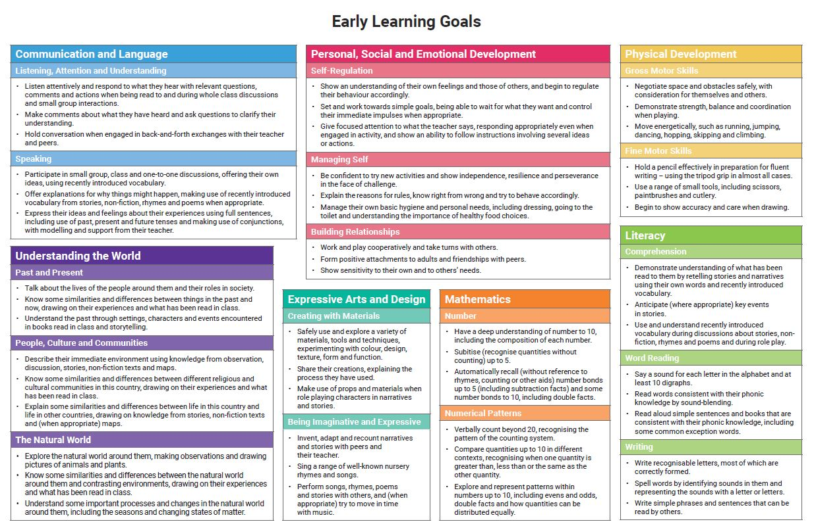
The EYFS curriculum
7 Areas of learning: Communication and language, Personal Social and Emotional Development, Physical development, Literacy, Maths, Understanding the world, Expressive Arts and Design
17 Early learning goals

Slide 8
Prime areas of learning
Communication and language
Personal, Social, Emotional Development
Physical development

Slide 9

Physical Development
PE lessons
Core strength, shoulders, arms, wrist, fingers
Funky fingers activities
Outdoor/nature time

Slide 10
Nature school
Wellies to be brought in and left in the classroom (for nature school and water play)
Long sleeved top and trousers
In the winter months a insulated all in one suit would be ideal!

Slide 11


Tapestry
Online learning journey.
Teachers will upload significant observations of the children in school
Parents can upload photographs from home and teachers will link this to the areas of learning.
Up to 4 family members can have access to learning journeys online.
Email addresses required for account to be set up

Slide 12


Homework
Monday to Monday
Activities will be based on need of the children
Will mostly focus on the letters that have been learnt in phonics that week

Slide 13
Parent and teacher communication
Valuable and essential. Always come to us first.
Appointments can be made through the office.
Reading diaries.
After school.

Slide 14


And Finally…
The support the children receive at home is crucial to your child’s development.
We are looking forward to a fantastic year with your children!

