Slide 1


Curriculum evening
2026-2027
Teaching and learning information for parents

Slide 2
Settling in
Settling in
Baseline assessment
Class rules
Behaviour – Dojo
All about me boxes
Nursery rhymes

Slide 3
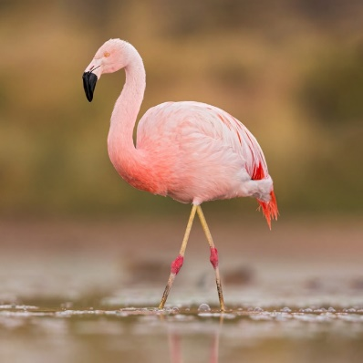


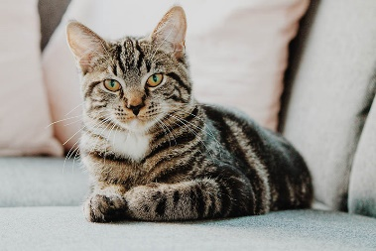
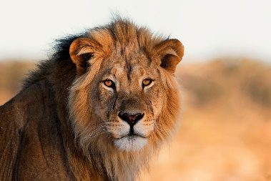
Ready, Respectful, Safe
1 – Always use kind hands and kind feet
2 – Always use kind words
3 – Always follow instructions
4 – Always learn and let others learn
5 – Always look after our school and everything in it

Slide 4
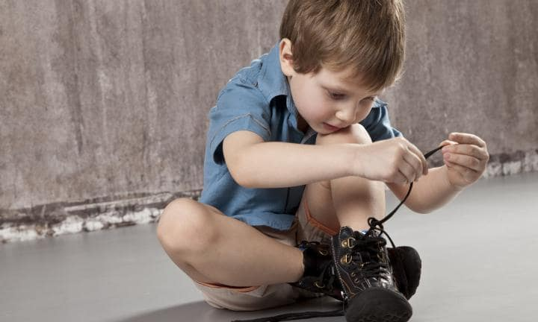


Reminders
PE kits – outdoor shoes (laces)
Names on everything!!!
No jewellery of any sort in school
The general rule across Stockport primary schools is that only small, plain stud earrings are permitted during normal classroom hours, and they must be removed for PE and swimming. Hoop earrings, drop earrings, and dangling designs are strictly banned across all schools due to the risk of injury. The guidance from the LA is 'taping' is not permitted and earrings must be removed.
All children need to bring in a water bottle
Book bag
Shoes – can your child put on their own shoes (laces)
Toileting

Slide 5
Attendance/ The school day
8:40 – 3:20
Children must not be left unattended before 8:40
Breakfast club (£4 from 7:45)
After school club - there are two sessions after school.
3.20pm-4.15pm = £4
3.20pm-5.15pm = £7
Term time holidays (not permitted)

Slide 6

School Street

Slide 7


Timetable and organisation
PE days are on a Monday. Children will need to come into school in their kits (white top, black joggers and black trainers)
Nature school on a Wednesday (clothing)
Homework TBC
Reading books expectation is to read every night (not the whole book!)
Reception fund £2 per half term

Slide 8


All about me
All about me box
In this box they can put in any photographs of family members, pets, special memories and objects or teddies that are special to them to share with their class.
The children will share their box one day next week with the class and talk through all the things that are special to them and make them happy.
Once the children have shared their box they will choose 2 photographs to then place on our display and will then take their box back home.
This activity is to show children our similarities and differences and to help with their listening and attention skills during group time.

Slide 9
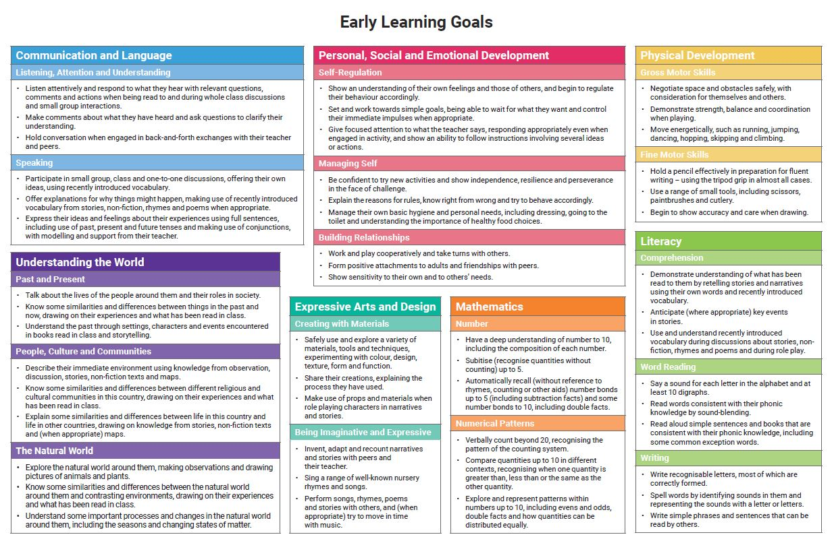
The EYFS curriculum
7 Areas of learning: Communication and language, Personal Social and Emotional Development, Physical development, Literacy, Maths, Understanding the world, Expressive Arts and Design
17 Early learning goals

Slide 10
Prime areas of learning
Communication and language
Personal, Social, Emotional Development
Physical development

Slide 11

Physical Development
PE lessons
Core strength, shoulders, arms, wrist, fingers
Funky fingers activities
Outdoor/nature time

Slide 12
Nature school
Wellies to be brought in and left in the classroom (for nature school and water play)
Long sleeved top and trousers
In the winter months a insulated all in one suit would be ideal!

Slide 13


Tapestry
Online learning journey.
Teachers will upload significant observations of the children in school
Parents can upload photographs from home and teachers will link this to the areas of learning.
Email addresses required for account to be set up

Slide 14


Homework
Activities will be based on need of the children
Will mostly focus on the letters that have been learnt in phonics that week

Slide 15
Parent and teacher communication
Valuable and essential. Always come to us first.
Appointments can be made through the office.
Reading diaries.
After school.

Slide 16


And Finally…
The support the children receive at home is crucial to your child’s development.
We are looking forward to a fantastic year with your children!

